Slide 1
Session 1
Database Design

Slide 2
Objectives
Understand the objective of this course
Review of Relational Database and SQL Server Fundamentals
Understand the design related contents of database design and related concept such as database modeling
Understand data normalization related with database modeling
Understand E-R Diagram and its implementation for designing database
Data integrity and its implementation
Understand data dictionary, Security design, Physical design related with database design

Slide 3
Review of relation database and SQL Server fundamentals
Need of database and various models related to a database
The concept of entity integrity
Primary key
Foreign key
Creation of tables in SQL Server 2000
The concept of enterprise manager, query analyzer
Defining integrity constraints and explain the constraints need to enforce it
The concept of T-SQL and the enterprise manager
SQL Server Data type and conditional expression
Manipulating data in a table using T-SQL
T-SQL statements to query exiting data
T-SQL statements to query existing data by group
Various aggregate function of SQL Server
INNER JOINS to query multiple tables in SQL Server 2000
Concept of export and import of data using conversion tools of the enterprise manger

Slide 4
Main Objectives of the course
Understand the process of database design and related concept such as database modeling
Understand the concept of Batch processing
Understand the concept of transactions
Understand the concept of lock and deadlocks in databases
Understand the SQL Server 2000 security policy
Mastering Sub-Queries, Indexes and Joins
Understand the concept of stored procedures and Triggers in SQL Server 2000

Slide 5
Database Design and Modeling
Database: Collection of data that is organized such that its contents can be easily accessed, managed and updated
Intelligent interpretation of data yields information
Designing a database: Define the structure of data object and relationships among these data objects within a database

Slide 6
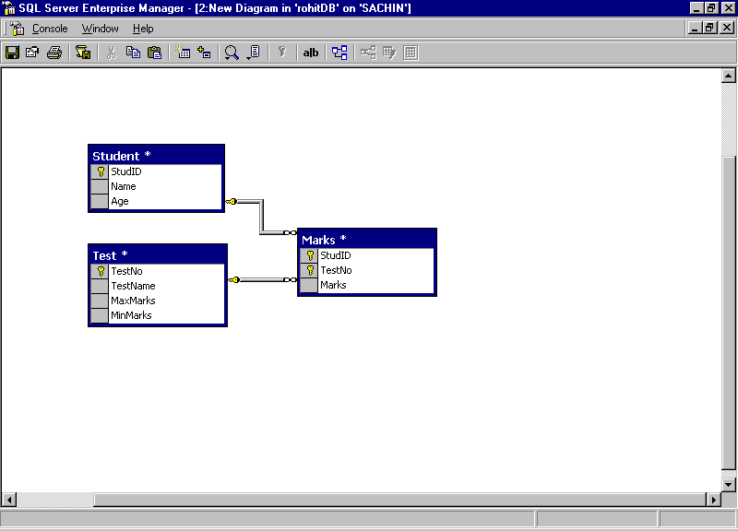
Student information database

Slide 7
More on Database Design
Poor database design:
  Poor efficiency
  lots of problems while updating and retrieving the data
Good database design:
  High efficiency
  easy further expansion
  easier application development

Slide 8
Designing a Database
Regardless of the size and complexity of the database, the following basic steps can be used to design a database:
  Gather the information
  Identify Objects
  Design the model
  Identify the type of information for each object
  Identify the relationship among the objects

Slide 9
Database Designing Steps
Gathering information
  Interview everyone involved in the system
  Identify what they want the new system to do
  Identify the problems, limitations, and bottlenecks of any existing system
  Collect Copies of customer statements, inventory lists, management reports, and any other documents that are part of the existing system
Identifying the Objects
  Identify the key objects or entities that will be managed by the database
  Tangible : a Person, a Product
  Intangible : a Business transaction, a department in a company, a payroll period
  Each distinct item in our database should have a corresponding table

Slide 10
Database Designing Steps Contd…
Modeling the Objects
  Record the objects in a way that represents the system visually
Identifying the Types of Information for Each Object
  Identify the types of information that must be stored for each object
  Raw data columns: Store tangible pieces of information such as names, Determined by a source external to the database.
  Categorical columns: Classify or group the data and store a limited section of data such as true/false, married/single, VP/Director/Group Manager, and so on.

Slide 11
Database Designing Steps Contd…
  Identifier columns: Provide a mechanism to identify each item stored in the table; Often have id or number in their names (for example, employee_id, invoice_number)
  Relational or referential columns: Establish a link between information in one table and related information in another table
Identifying the Relationships between Objects
  Looking at the tables
  Determining how they are logically related
  Adding relational columns that establish a link from one table to another

Slide 12
Data Modeling
Business Information Requirements
Conceptual Data Modeling
Business view
Logical Database Design
Systems view
Physical Database Build
Operational Database

Slide 13
Conceptual Data Modeling
High-level abstract data model
Conceptual schema is a permanent description of the database requirements
Independent of DMBS
3 types of abstractions are considered
  Classification
  Aggregation
  Generalization

Slide 14
Database Logic Design
Information used in an enterprise based on a specific data model
Independent of a particular DBMS or other physical considerations
Entity Relationship Model : DB Design process and represents the overall logical structure of the DB
  Entity : An entity is an object that exists and is distinguishable from other objects. An entity may be concrete (a person or a book, for example) or (like a holiday or a concept).
  An Entity set: Entity set is a set of entities of the same type (e.g., all persons having an account at a bank).
  Attributes: An entity is represented by a set of attributes. For example: Name, SSN, Age, Street, City for “Person” entity.
  Relationships and Relationship sets : A relationship is an association among two or more entities. A relationship set is a collection of relationships of the same type.

Slide 15
Relationships
CustAcct
Customer
Account
Binary Relationship
Borrow
Customer
Loan
Branch
Ternary Relationship

Slide 16
Types of Relationships
X
X
X
X
Y
Y
Y
Y
X
X
X
X
Y
Y
Y
Y
One to One
One to Many
X
X
X
X
Y
Y
Y
X
X
X
X
Y
Y
Y
Y
Many to One
Many to Many

Slide 17
E R Diagrams
One To Many
Street
Date
Acct_Number
Cust_Name
City
Acct_Type
CustAcct
Depositor
Customer
Account
Street
Date
Acct_Number
Cust_Name
City
Acct_Type
CustAcct
Depositor
Customer
Account
One To One

Slide 18
E R Diagrams Contd…
Street
Date
Acct_Number
Cust_Name
City
Acct_Type
CustAcct
Depositor
Customer
Account
Many To Many
E-R diagram with a weak entity set
Trans_Number
Amount
Acct_number
Acct_Type
Date
Log
Account
Transaction

Slide 19








E-R Diagram notation
Symbol | Meaning
 | ENTITY TYPE
 | WEAK ENTITY TYPE
 | RELATIONSHIP TYPE
 | ATTRIBUTE
 | KEY ATTRIBUTE
 | MULTIVALUED ATTRIBUTE
 | COMPOSITE ATTRIBUTE
 | DERVIED ATTRIBUTE

Slide 20
Data Normalization
Normalization
  Reduce a database structure to its simplest form
  Remove redundant columns from tables
  Identify all data that is dependent on other data
Forms
  The first normal form (1NF)
  The second normal form (2NF)
  The third normal form (3NF)
  The fourth normal form (4NF)
  The fifth normal form (5NF)
Other Concepts
  Functional Dependency
  Anomalies : Insertion, Update and Deletion

Slide 21
Process of Normalization
Remove repeating columns from the table to attain the first normal form.
Remove data not completely dependent on a primary key from the table to attain the second normal form.
Remove data that does not belong in the table (items wholly dependent on another column or foreign key) to put data in the third normal form.
Test that each row of the table shows one significant fact.
Bring back a certain amount of redundancy into the table to improve performance by avoiding the need to do cross-table joins. The process of adding redundancy to improve performance of a database is termed de-normalization.

Slide 22
Normal Forms
A relation is in 1NF if and only if all underlying domains contain atomic values only.
A relation is in 2NF if it is in 1NF and every non-key attribute is fully dependent on each candidate key of the relation.
A relation R is in 3NFif it is in 2NF and every non-key attribute of R is non-transitively dependent on each candidate key of R.
Reducing E-R Diagrams to Tables
  For each entity set and relationship set, there is a unique table
  Each table has a number of columns (attributes) with unique names

Slide 23
Other factors in Database Design
Data Dictionary
  Data element definitions may be independent of table definitions or a part of each table definition
Data Types
Enforcing Data Integrity
  Reliability and accuracy of data
Database server Design

Slide 24
Summary
Dynamic pages web pages can be created using
  Server-based scripts
  Client-side scripts
  Dynamic HTML
ASP is a technology that provides a Web server with the capability to process application logic and return standard HTML to the browser.
VBScript is a subset of the Visual Basic language and supports most of its syntax and structure.

